Slide 1
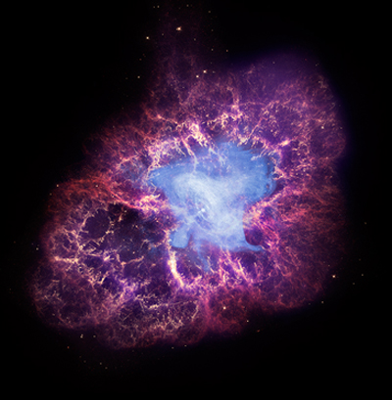

Crab Pulsar Scintillometry
Xiaozheng (Judy) Xu
Supervisor: Ue-Li Pen
Collaborators: Robert Main, Martin van Kerkwijk
Aug 18, 2016
Notes:
Background information:
Once upon a time in 1054 a supernova exploded and the crab pulsar was born with a beautiful nebula surrounding it.
Its rotates every 30 ms and has unusual and enigmatic emission mechanisms that intrigue us to study.

Slide 2
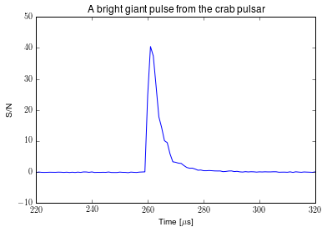
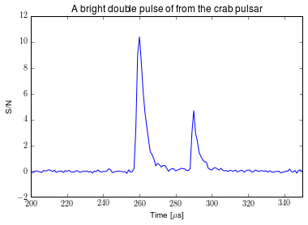
Giant pulses from the crab (‘M1’)
Notes:
Some of the pulses of the crab are especially bright so we call them giant pulses.
Here is how a giant pulse looks like. Occasionally, the crab emits a double pulse, that is 2 pulses very close together in time, separated only by 30 microseconds. Here is 1 of them.. This one is particularly important.. You might notice the asymmetric pulse structure and scattering tail.. Why is that?

Slide 3

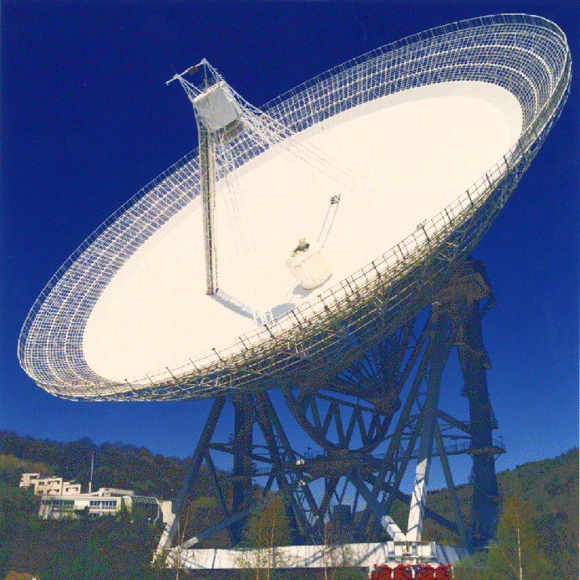
Nebula screen
The crab pulsar in its nebula
Effelsberg radio telescope (100m in diameter) in Germany
Notes:
1 min
Scintillation by the nebula screen
Go through animation
Screen acts similar to refracting lens
The top image arrives later than the route along the direct line of sight, and that’s what causes the scattering tail of the giant pulse..
The different paths superimpose at the telescope and creates scintillation pattern
As the pulsar moves with respect to the nebula screen, the pulses see a different part of the screen each time and as a result the scintillation pattern changes with time.

Slide 4
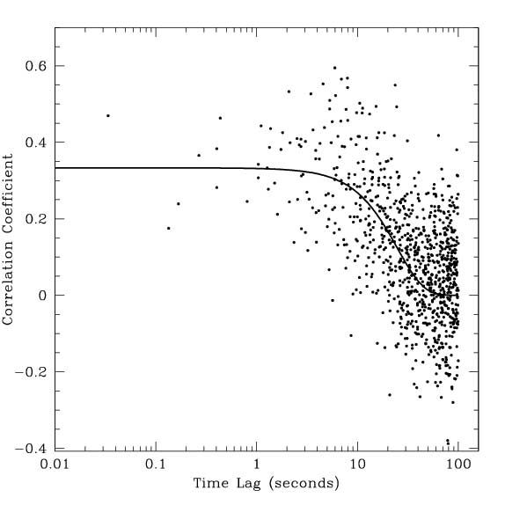
Findings by Jim Cordes
Data recorded in 2002 at 1.45 GHz using Arecibo radio telescope
Corde’s plot which shows how the frequency spectres of pulses decorrelate as they are separated more and more in time. He estimated a decorrelation time of 25s.
Figure 12 in Cordes’ paper:
“The Brightest Pulses in the Universe: Multifrequency Observations of the Crab Pulsar’s Giant Pulses.”
Notes:
That is exactly what Jim Cordes
Tell them what the axes are
We expect that if we wait long enough -→ pulsar drifts → pulses would have different scattering properties

Slide 5
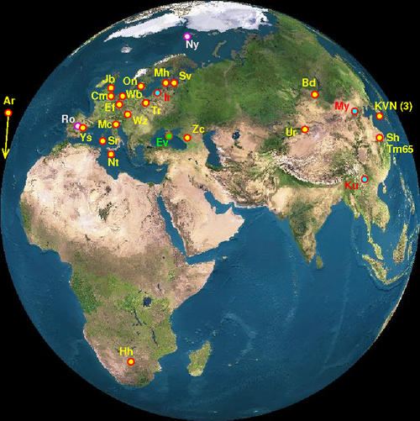
Data is recorded with the European VLBI (Very long baseline interferometry) network of radio telescopes
Year: 2015
Frequency: 1.61 GHz
EVN (European VLBI network)
Notes:
New data:
At first we used only data at the single radio telescope effelsberg and jordrell bank. Then we realized that noise is messing up our methods so we incoherently added up the nine telescopes circled in green to increase signal to noise of all our pulses. On average, the signal to noise was increased by 2 times compared to the baseline of Effelsberg from this procedure.

Slide 6
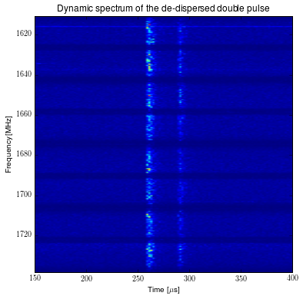
Data processing
Notes:
-Data arrives as time stream
-De-disperse it using what Can has talked about
-Fourrier transform into frequency
-Take the frequency spectres of the brightest four time bins to find a correlation coefficient.

Slide 7
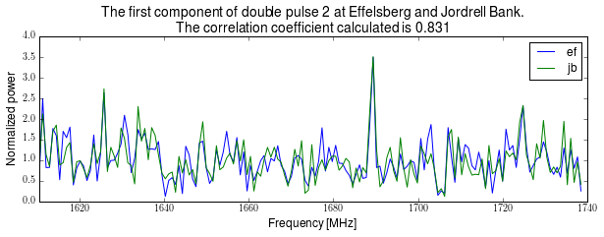

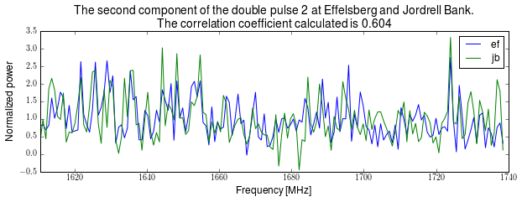
Finding a correlation coefficient
Notes:
So now we can find a correlation coefficient using this formula.. The sigma noise square compensates for the noise.
To validate my method, I plotted the first component of the double pulse at effelsberg and jordrell bank. Because the two telescopes are very close together, they should see a very similar scintillation pattern.. As you can see, the pulse at the two telescopes look very similar and we get a correlation coefficient of 0.831.
Then I plotted the second component of the double pulse at the two telescopes and got a correlation coefficient of 0.604. So they are clearly well correlated..
Now to the results..

Slide 8
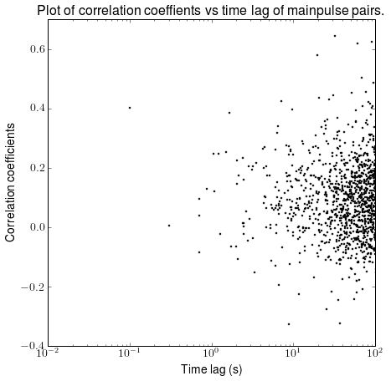
Results
We were unable to reproduce Cordes’ results.
There is no positive correlation even at short time lags
Notes:
After trying many different methods and increasing signal to noise, we were unable to reproduce Cordes’ results.
We don’t find much correlation even at low time lag separation..
I have the same axis as Cordes
Can fit a straight line through..

Slide 9
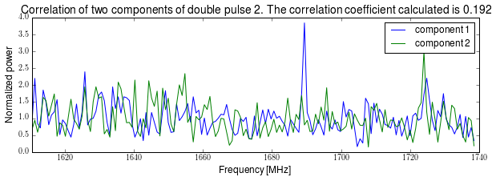
Closer pulses further to the left of the previous plot
These two components of this double pulse is separated about 30 microseconds apart, however, they are only 0.2 correlated.
Notes:
Even more surprising is when I tried to correlate the two components of the double pulse. They are separated only by 30 microseconds but they are only correlated by 0.192.
That is quite low given that the two pulses are literally at the same time and must see the same nebula screen.
So what does this mean physically?

Slide 10
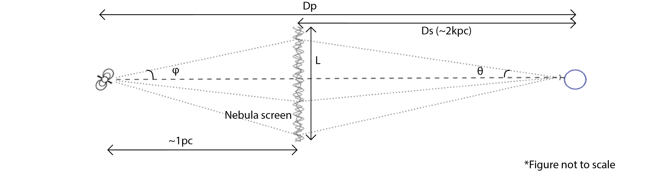




Resolving the pulsar using its nebula screen
$φ$
$$τ= \frac{θ^{2}D_{eff}}{2c}≈10 μs$$
$$D_{eff}=\frac{D_{p}D_{s}}{D_{p}−D_{s}}$$
Telescope resolution equation:
$$φ=\frac{λ}{L}=\frac{\frac{c}{1610MHz}}{θD_{s}}≈1.37×{10}^{−11}$$
Physical resolution of the pulsar :
$$φ\left(D_{p}−D_{s}\right)≈422km$$
$$θ≈2.2×{10}^{−10}$$
Notes:
1 min:
-To help explain this, I will first try show you the resolution of the pulsar’s nebula screen as a telescope.
-The nebula screen is about 2kpc away from us, the pulsar is about 1pc further away from us..
-Tau is the scattering time, which is the duration of the scattered pulse, which I can measure from my giant pulse data.
-Explain the graph..
What does my result mean?
-The resolution means that if two pulses correlate well, they are likely to be emitted from locations within the resolution size.. If they don’t correlate well, the pulses are emitted from two different location separated greater than the resolution size.

Slide 11
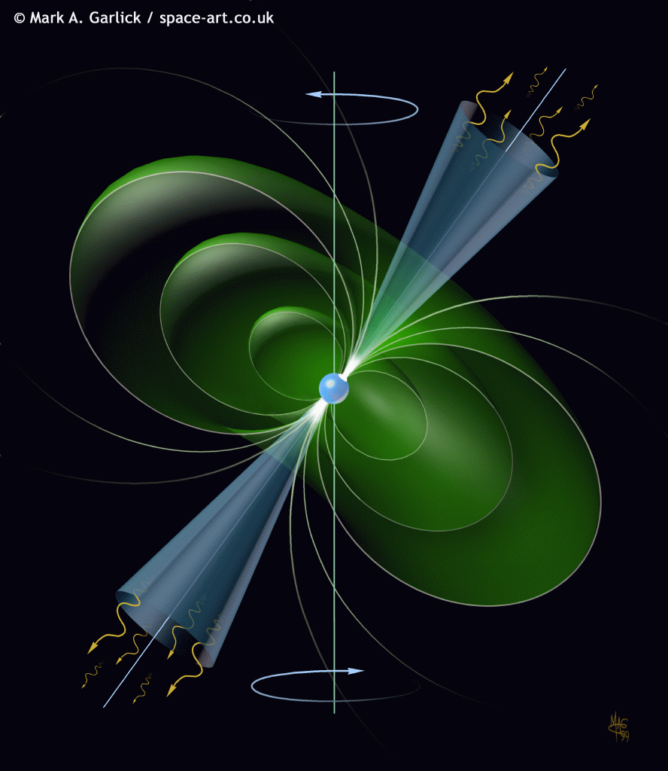
Interpretation of results
The nebula environment has changed between 2002 and 2015. We have a longer scattering time of ~10µs while Cordes’ had ~1.5 µs.
Pulses might not come from a singular location each time, but rather ‘bounces’ around in the pulsar’s magnetosphere on a scale larger than the nebula screen’s resolution.
Various models about the crab’s emission mechanisms have been proposed and debated. Knowing where the main pulses come from can support and refute these models.
(See “Radio Emission Physics in the Crab Pulsar” by Eilek and Hankins in 2016 for details)
Notes:
1 min

Slide 12
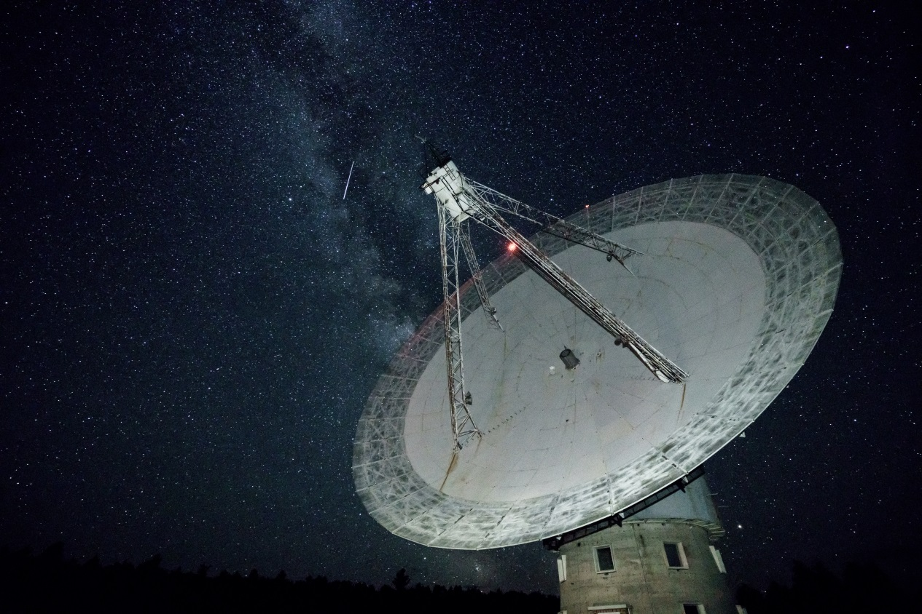
Thank you for listening
Algonquin radio telescope,
Photo credit to André.

Slide 13
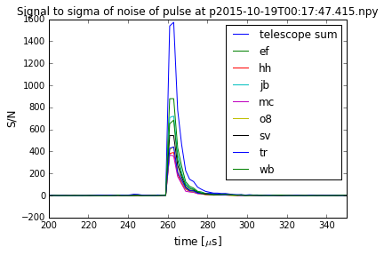
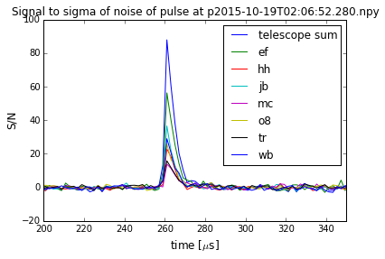
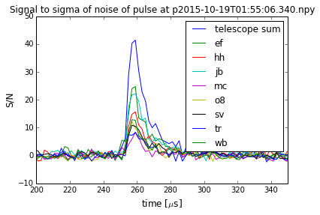
Incoherently adding up telescopes
About 2 times S/N increase compared to baseline of Effelsberg

Slide 14
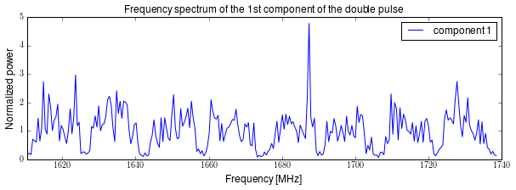
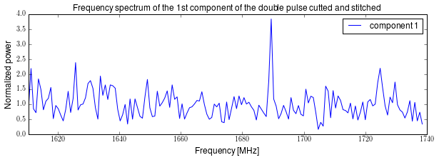
Processing the data
Notes:
Pulse arrives at the telescope as a time stream
We fourrier transform that to get a frequency power spectrum
8 bands because of the bandpass filter shape of the telescope gain..
Keeping the shape will positively influence our correlation coefficient
So we cut out the useless bands in between and stitch them back together..

Slide 15
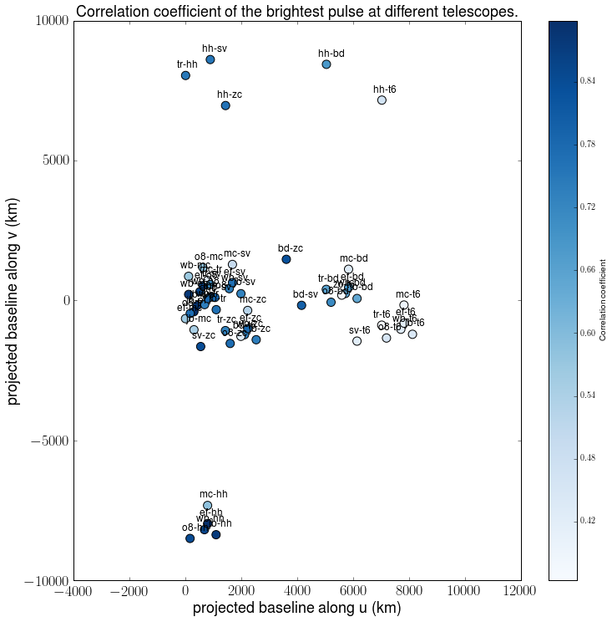
Notes:
Resolving the interstellar screen with VLBI
-Explain what projected baseline along u and v are (distance between two telescopes in the reference frame of the pulsar) u is roughly the same as EW and v is roughly the same as NS
Correlating the brightest pulse at Shanghai’s tm65 with the rest of the telescoepes have a smaller coefficient → We might be resolving the interstellar screen using a baseline of about 6000 to 8000 km..

